Slide 1
SPEAKING QUESTION
TOFEL

Slide 2

SPEAKING QUESTION 1 & 2
INDEPENDENT SPEAKING

Slide 3
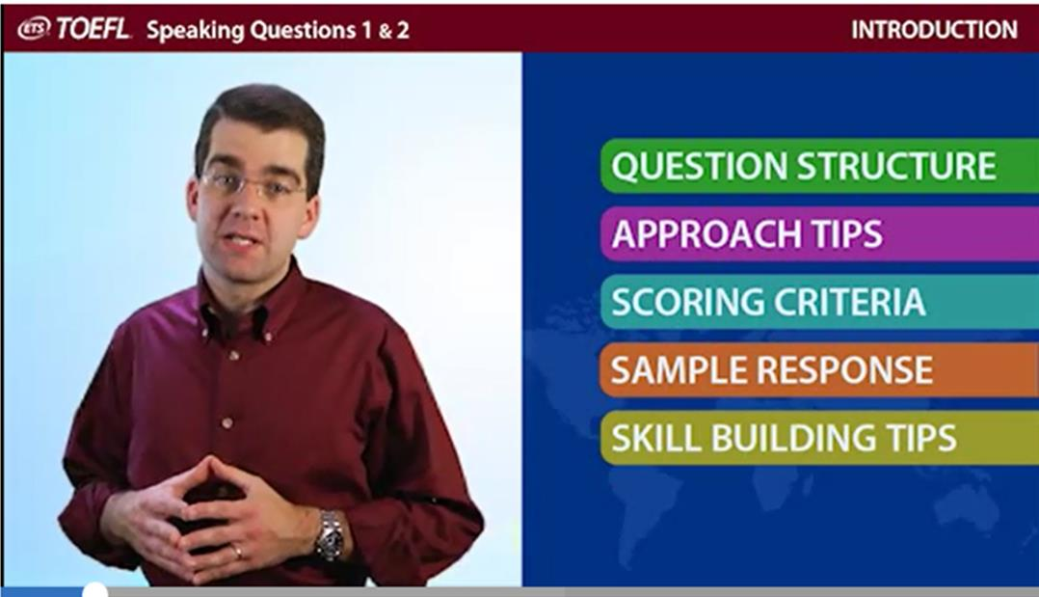


Slide 4
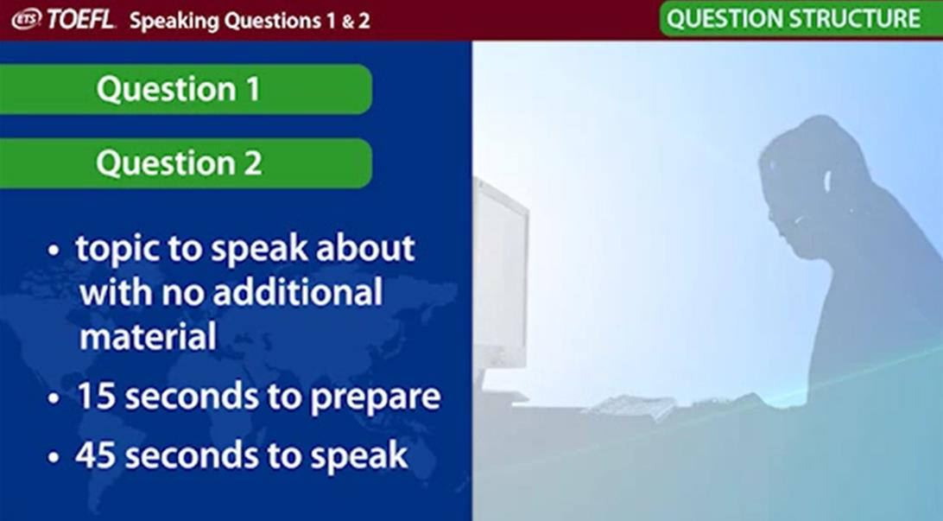

Slide 5
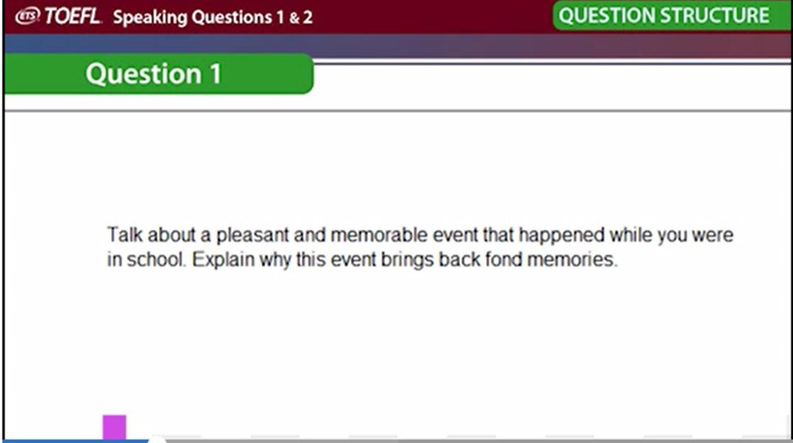
Notes:
Question 1 will ask you to speak about person, place, object or event that is similar to you.

Slide 6
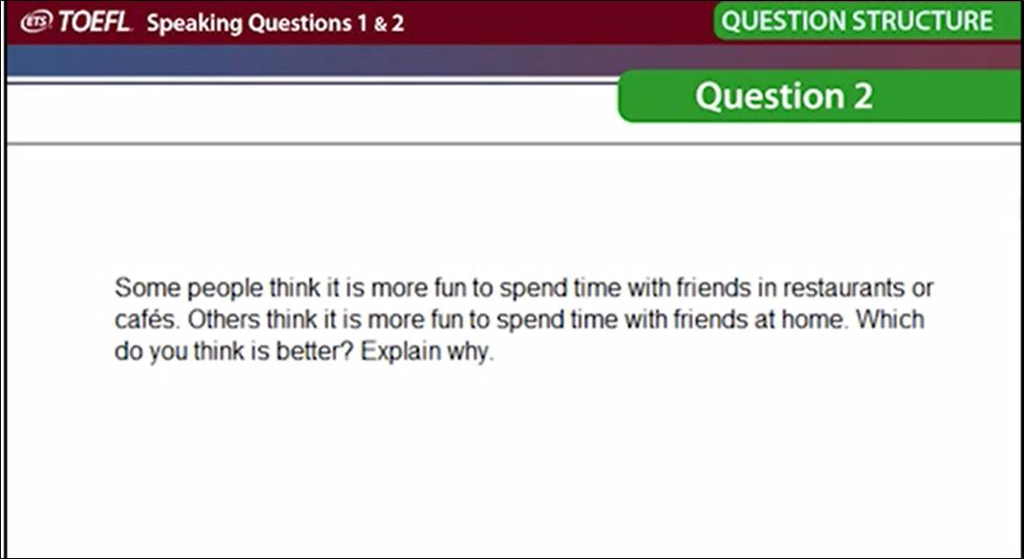
Notes:
Question 2 will give you to situation and will ask which one you prefer and explain your choice

Slide 7
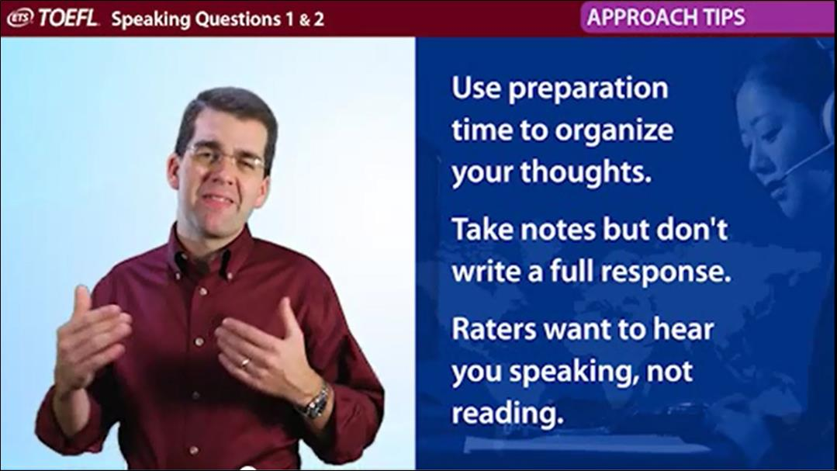

Slide 8
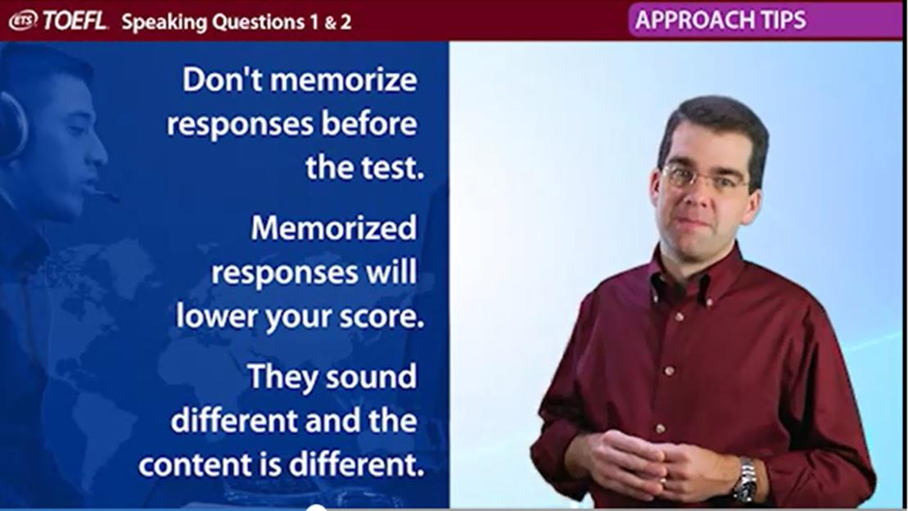

Slide 9
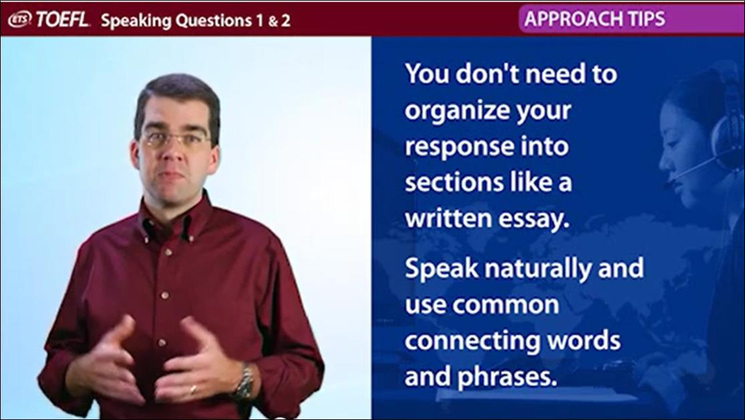

Slide 10
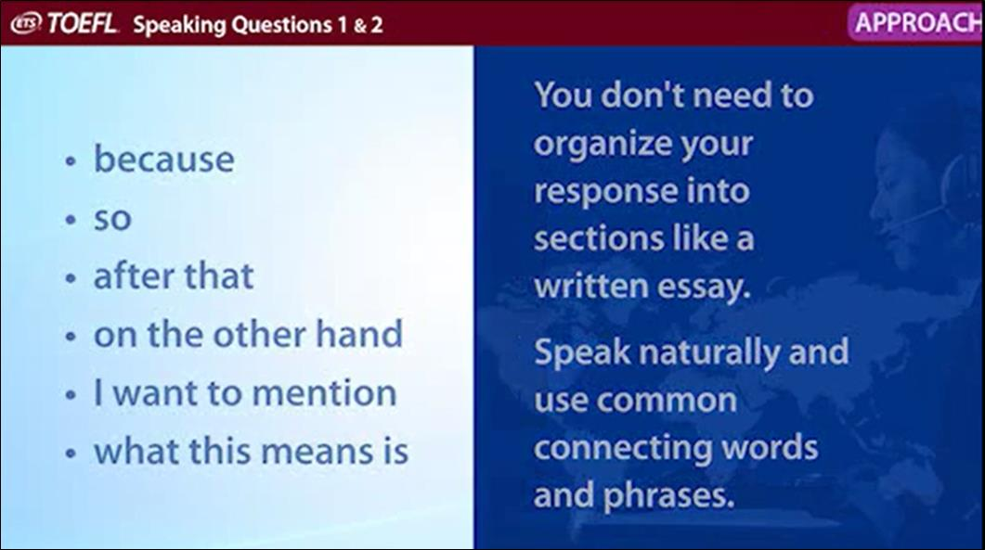

Slide 11
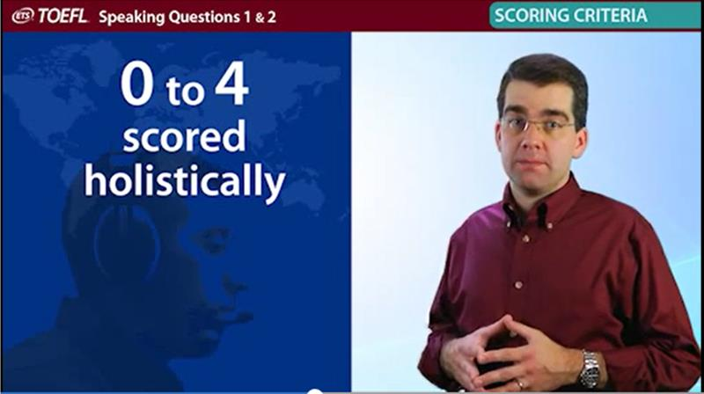

Slide 12
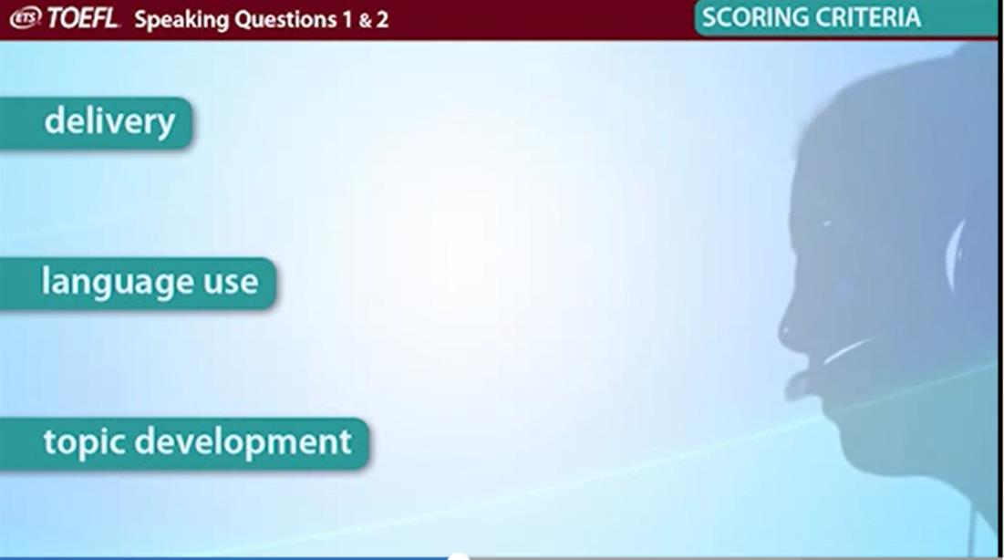

Slide 13
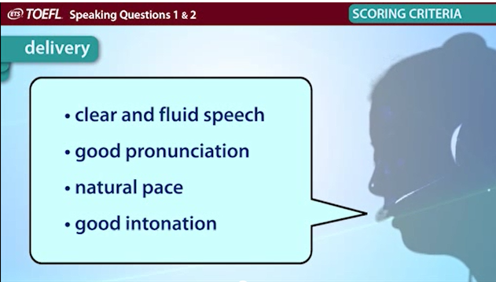

Slide 14
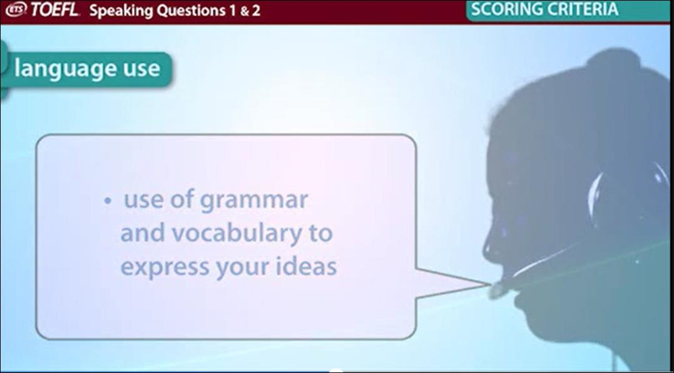

Slide 15
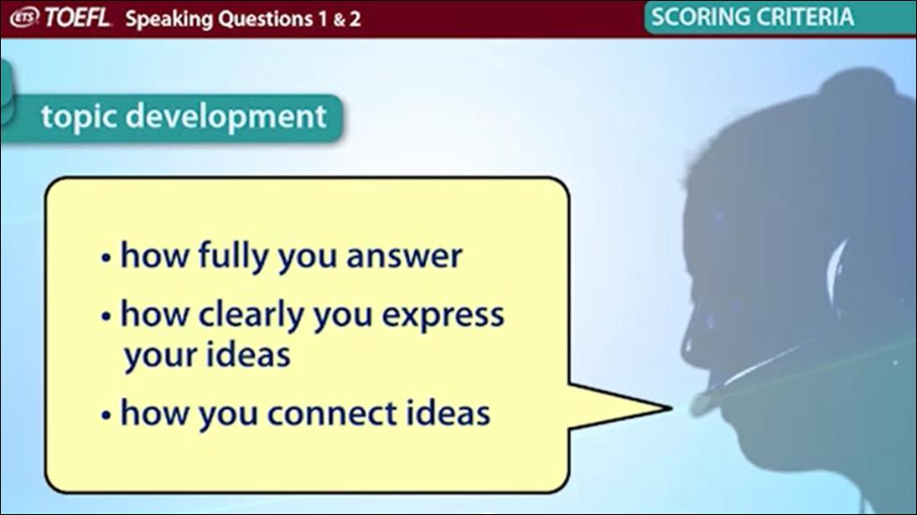

Slide 16
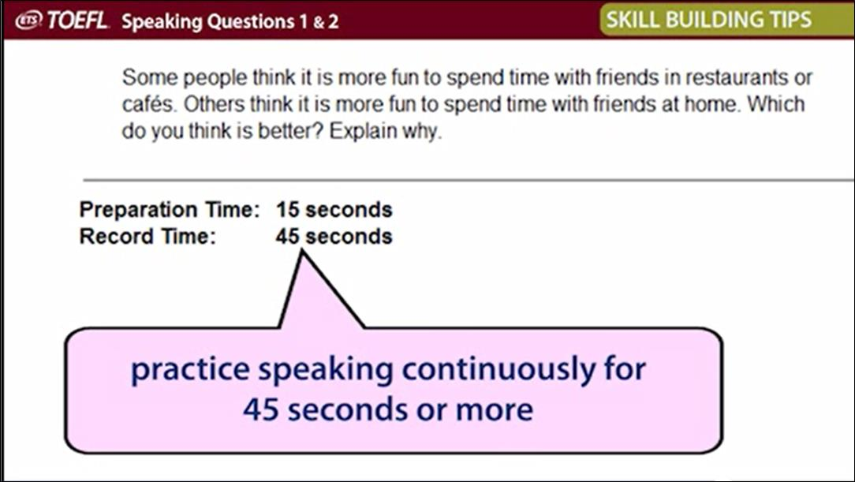

Slide 17
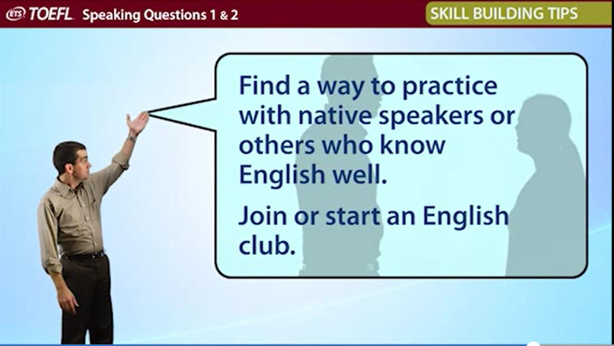

Slide 18
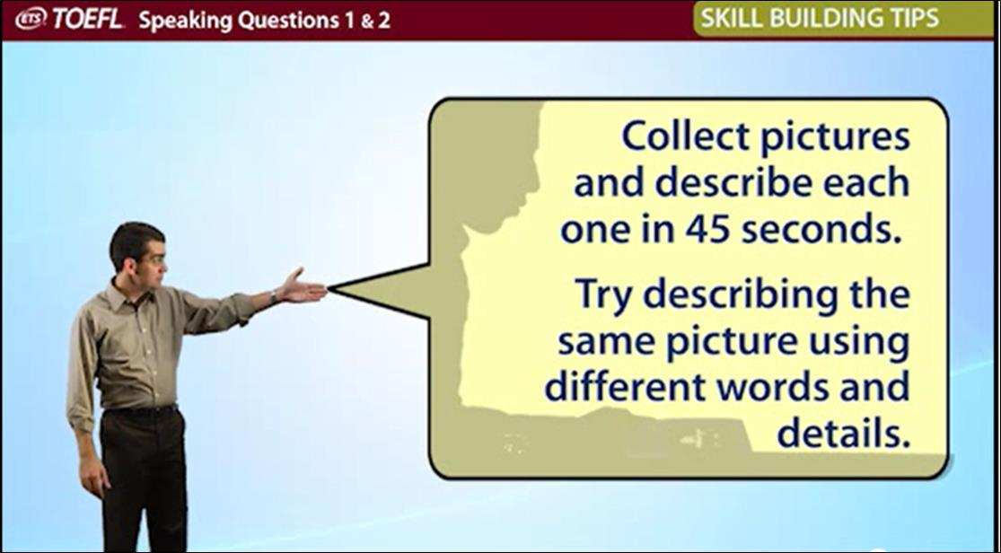

Slide 19
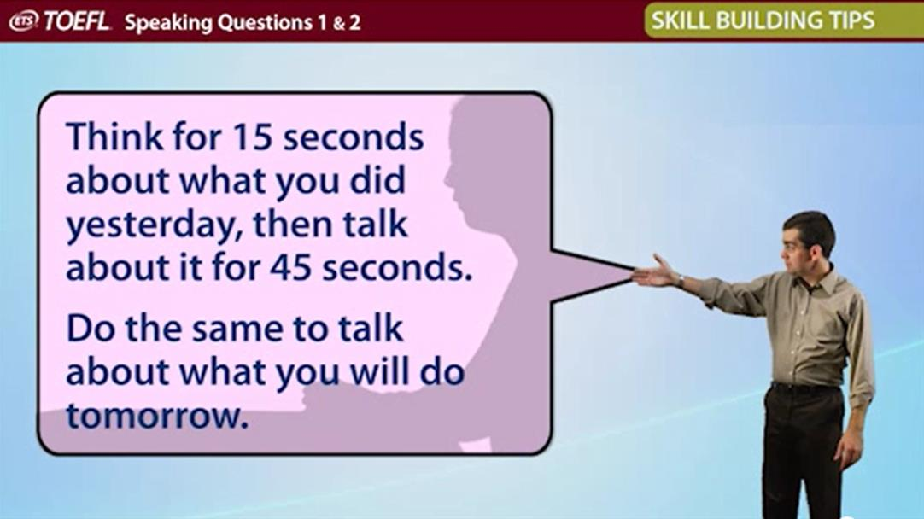
Notes:
Try to talk about yesterday in past tense and about tomorrow in future tense.

Slide 20
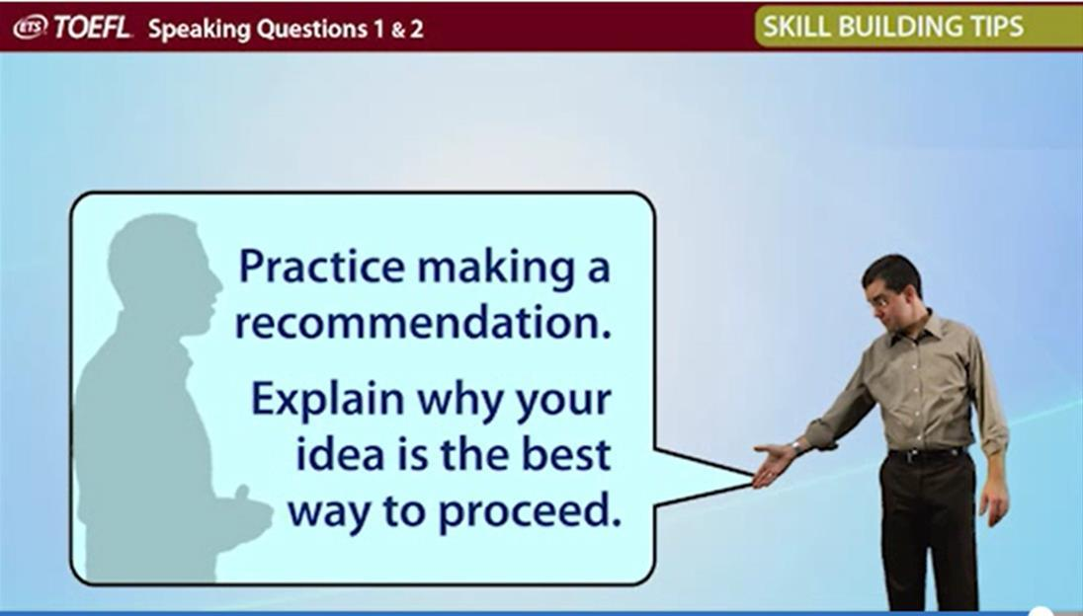
Notes:
Find a topic you are interested, make your recommendation and explain why your idea is best to proceed

Slide 21
E N D

